Slide 1


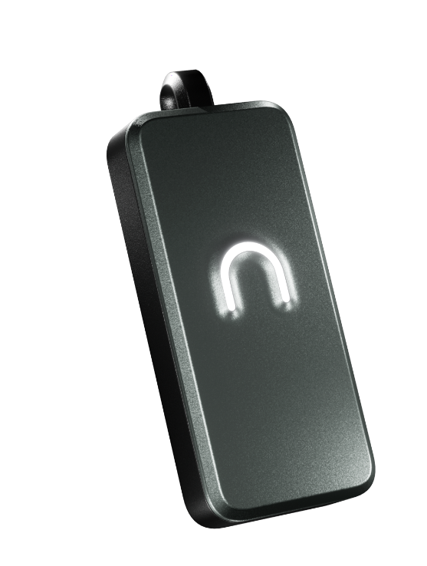
NeoCore
Building Personal AI That Actually Knows You
The future of business intelligence

Slide 2

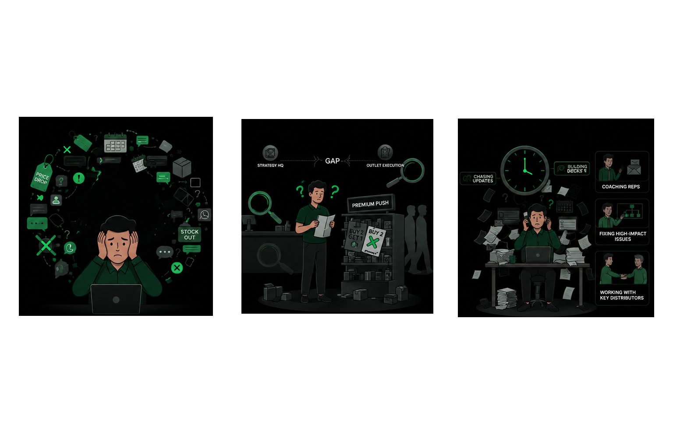
The Problem Field conversations are a goldmine AND a graveyard of critical intelligence
Building Personal AI That Actually Knows You
Critical intelligence is conversational
Conversational insights are inaccessible at scale
Leading to low employee productivity
Leaders necessarily need to be in the frontlines, and even then, field insights are partial
Leaders burn 30% of their time chasing updates instead of coaching or fixing issues; field teams operate at sub-optimal productivity
Critical signals - Competitor price drops, scheme failures; stay informal and are passed verbally

Slide 3

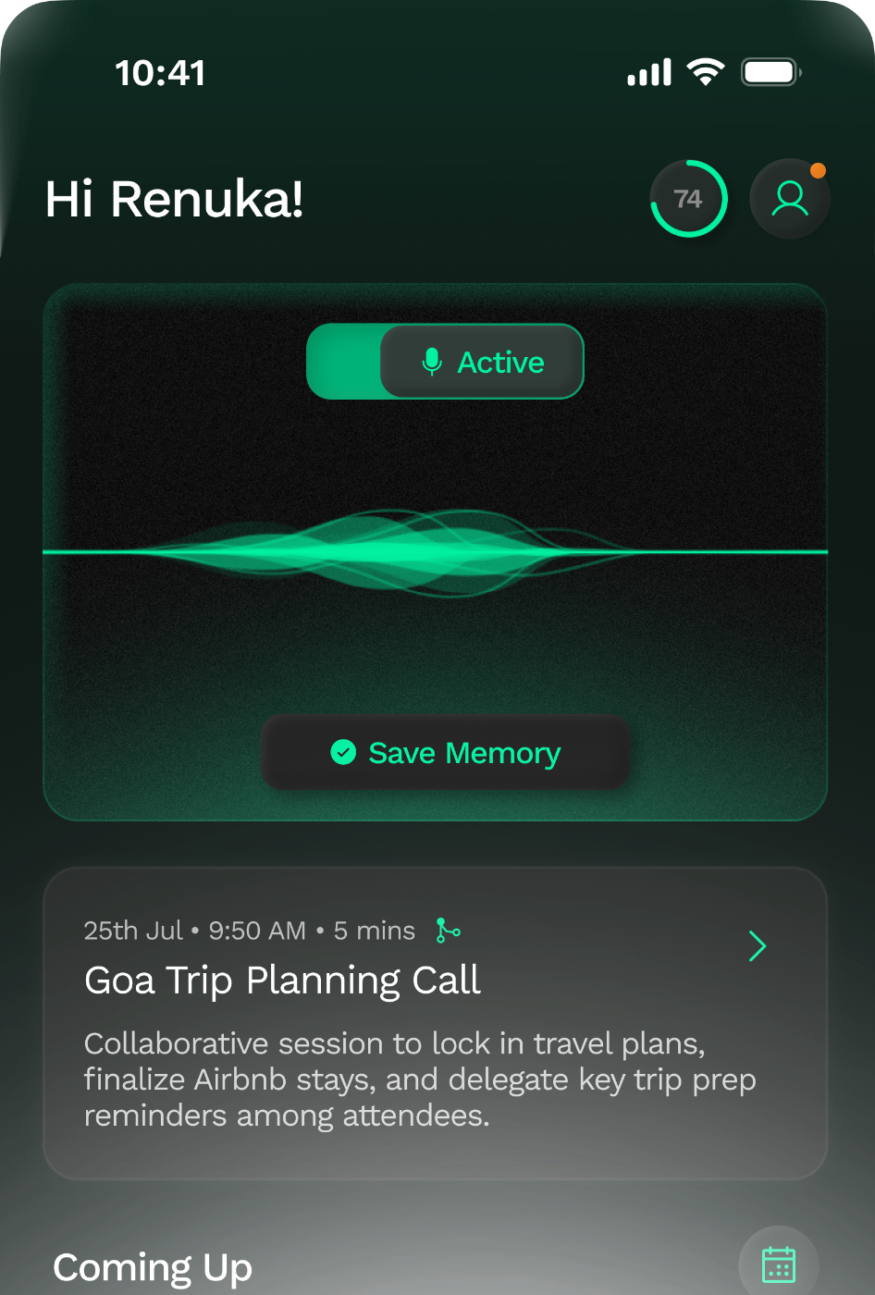
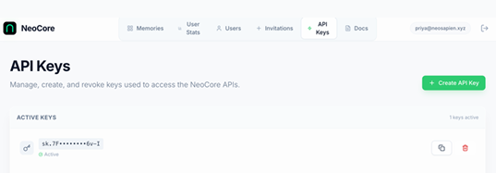
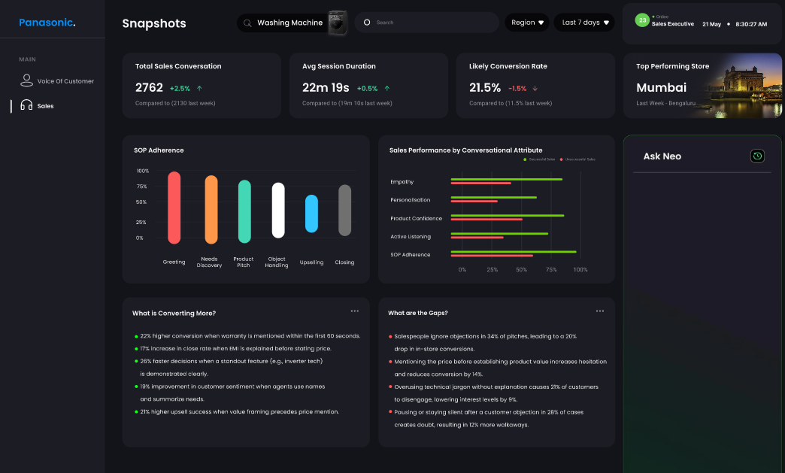
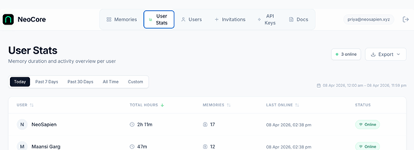
Our solution - NeoCore We transform conversations into enterprise-scale intelligence & actions
Core offering
Add-on*
Building Personal AI That Actually Knows You
Seamless conversation capture and synthesis
Enterprise-level aggregation
Custom insights to drive business outcomes
Always-ON, ambient listening device
Breakthrough voice AI tool
Central “data dashboard” with synthesis of all conversations
APIs and MCPs to integrate with your systems
Pitch adherence tracker – “Ideal pitch” adherence score for each chat
Voice of customer chatbot
Personalized coaching manuals for salespeople
(*) Add-on offering under a separate commercial construct from the first 2 parts of the enterprise offering

Slide 4






Why NeoCore
01
02
03
04
Breakthrough technology
Tailored to your needs
Easy usage for real business outcomes
Best-in-class security & privacy
85%+ speaker attribution accuracy, 100+ languages, <2 min latency from speech to synthesis; patented technology to capture emotions
Customization to suit your context, and lingo
Always on option leading to high levels of utilization (70%+) with tangible impact (e.g. 15-20% uplift in sales productivity)
ISO 27001 certified
SOC2-compliant vendors
JWT auth
Bi-annual 3P audits
PII/ personal conversation redaction
No audio storage
05
06
07
Trusted by industry leaders
API-first
Made in India
Live at 25+ customers including multiple marquee logos
Seamless integration into your organization’s applications
Developed, manufactured, maintained in India.

Slide 5

Breakthrough technology
BREAKTHROUGH INTELLIGENCE LAYER
COMPETITIVE WITH GLOBAL BEST IN CLASS
87%+
Diarization accuracy for multi-agent conversations*
Neo Core
Plaud NotePin
ACCURACY
Indic language coverage
40+
100+ (22 Indian)
14
Diarization accuracy
85%+
Not published
100+
Languages; significant coverage of Indic languages
Latency
<2 mins^
Not published
RELIABILITY
Battery life
17 hr cont.
~20 hr cont.
<2 min
Latency from speech to synthesis^
Warranty
1 yr (add on)
1 yr
DATA SECURITY
Certifications
ISO 27001
ISO/SOC2/HIPAA
Trains on user data
No
Not published
2
Patents - emotion-sensitive technology captures emotional states in each conversation
SUPPORT
Software support
100% dedicated
Standard business tier
Hardware support
Local · 1-wk SLA
Import only
(*) For multi-speaker settings with clear audio stream; 4% reduction if ambient noise present (^) Median duration

Slide 6



Tailored for your needs
Your language
Your context
Your dashboards
Trained on your products, brands, competitor names and regional sales lingo
Customisable note structures – topics to be captured can be configured for your needs
Integration services to combine NeoCore insights with your systems and data sources
We tailor NeoCore’s proprietary AI engine to enable hyper-relevance to your use-case

Slide 7





Best-in-class security and privacy
SECURITY
ISO 27001 certified; DPDP compliant
SOC 2-compliant vendors
JWT authentication
Audits every 6 months
Certified information security management
Every third-party service in our stack meets SOC 2 compliance standards
Token-based auth with rotation and scoped access for every API consumer
Independent vulnerability testing and penetration audits on a fixed cadence
PRIVACY
No audio storage by default
No training on your data
India-resident servers
PII/ Personal conversations redacted

Slide 8















Trusted by industry leaders Ongoing engagement on 20+ use cases across industries
INDUSTRIES
USE-CASE CLUSTERS
FMCG
Automotive
Sales effectiveness
Pitch tracking, sales training, conversation insight aggregation
BFSI
Healthcare (Provider, Pharma)
Market research
Retail
Real Estate
Research panel training, VoC automation and analytics
Service excellence
Media
Market Research
Ambient scribing, resolution follow-ups, product intelligence and failure points
Education
Consumer Durables
Ambient scribing
Transcription of critical conversations
… and many more
SOP & compliance
Group- and individual-level adherence in offline conversational settings

Slide 9























Trusted by industry leaders Engagement with leaders across sectors
CPG/ DURABLES
AUTOMOTIVE
REAL ESTATE
OTHERS
RETAIL/ MEDIA
PUBLIC SECTOR
+ Growing clientele of 25+ SMBs
Pilots underway

Slide 10





Case study (1/2) – Leading FMCG Co. Rollout at leading FMCG Co. in partnership with Bain & Company and Palantir
Inputs
Insights
Outputs
NeoSapien
Bain/ Palantir
Field sales Copilot – Provides inputs for DSRs for field sales conversations basis historical conversation/ sales context
Pendant
(Voice capture)
Pendant app
(Keeps device connected)
Pitch tracker – Tracks adherence to recommended talk track
Captures field signals from DSR interactions across 100+ languages
Synthesizes field signals into tagged, queriable qualitative data stream
Connects to data systems via APIs/ MCPs
Ingests data and synthesis of conversations from DMS/ SFA & interprets context using AI models, business rules
Generates guidance tailored to DSR, outlet
Measures and tracks key leading metrics (e.g. adherence to pitch), correlates with outcomes (e.g. lines per store)
Improves continuously with adoption & sales outcomes
Executive chatbot – Provides real-time visibility on feedback from field – product quality, pricing, availability, positioning
Outcomes
CPG Co
15%+
Increase in lines per store
Outlet data history
20%+
Beat data history
Increase in sales per store

Slide 11
Case study (1/2) – Leading FMCG Co. Example output from a sales conversation
Custom fields based on what FMCG Co. wanted reps to talk about
**What was pitched**
- Txx Sxxx masalas: haldi, mirch, dhaniya, hing (₹6.40/piece scheme on ₹10 packs)
- Cxxx's range: Schezwan chutney, Hakka noodles, fried rice masala, Manchurian masala, pasta masala, peri peri
- Oxxx: green tulsi tea with honey free, pink salt, coconut oil, ghee, jaggery powder
- Sxxx Rxxx Bxxx wafers (₹5 retail, ₹122 for 2 boxes scheme)
- Txxx Sxxx pulses: toor dal, rajma chitra, moong dal, besan
- Sxxx ginger garlic paste (₹47 MRP at ₹29-30 on 12 pieces)
**What was asked**
- Better margins on products
- Faster delivery and supply consistency
- Proper address and phone numbers for delivery
- Scheme details on various products
- Competitor pricing comparisons
**What worked**
- Jain Provision Store placed large order (₹16,000+) including Oxxx products, masalas, pulses, Schezwan chutney
- Retailers responded positively to Ragi Bites wafer samples
- Scheme pricing on masalas (₹6.40 for ₹10 MRP) attracted interest
- Oxxx green tea with free honey offer well received
**What didn't work**
- Delivery delays at Deepchand store (5 days pending) causing retailer anger
- Multiple order cancellations due to incorrect addresses/phone numbers
- Sharma General Store declined most products, only took small order
- Price resistance on premium products like Oxxx Mxxx tea (₹190 vs ₹244 MRP)
- Several retailers cited Rxxx and Mxxx as cheaper alternatives for masalas
**Follow-ups**
- Resolve Deepchand Kalyanpuri delivery (5 peti chutney + 5 peti fried rice pending)
- Correct outlet addresses in SFA system for smooth delivery
- Supply shortage issues to be addressed (hing, arhar dal out of stock)
- Retailer app download and scanning to be completed
Keyword boosting to capture brand names accurately
Action items surfaced to salesperson out of each conversation

Slide 12
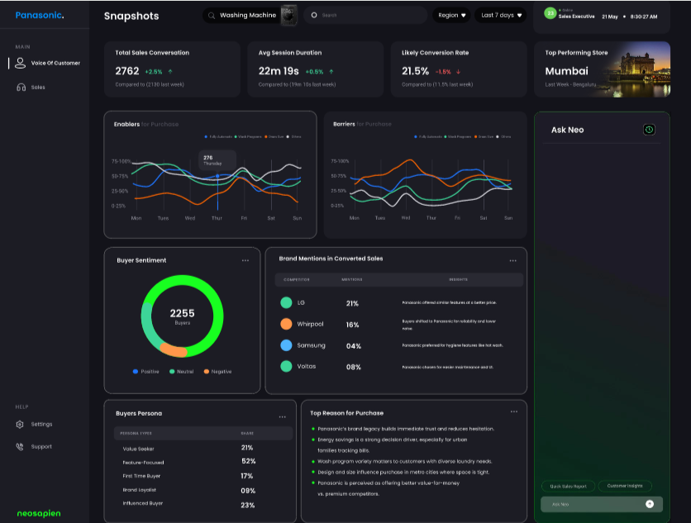
Case study (2/2) – Leading Consumer Durables Co. Custom dashboards to track pitch adherence, voice of customer insights
Pitch adherence dashboard
Voice of Customer dashboard

Slide 13



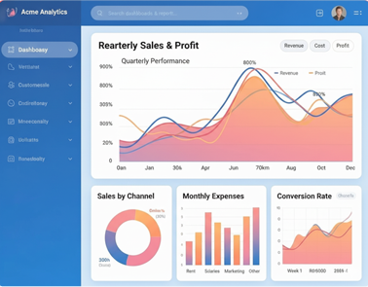
API-first for seamless integration into your workflows
/ ILLUSTRATION FOR SALES
YOUR ANALYTICS
CRM
Customised dashboards
Combine conversation intelligence with your sales and demand data to build the views your business actually needs.
EXTERNAL DATA
Sales & industry data
FIELD INTELLIGENCE
Conversations on NeoCore

Slide 14



Take the leap into conversational intelligence
Prashanth
enterprise@neosapien.ai

